Slide 1
Impairment in Functioning and Quality of Life in Patients With Idiopathic Hypersomnia: the Real World Idiopathic Hypersomnia Outcomes Study (ARISE)

Slide 2
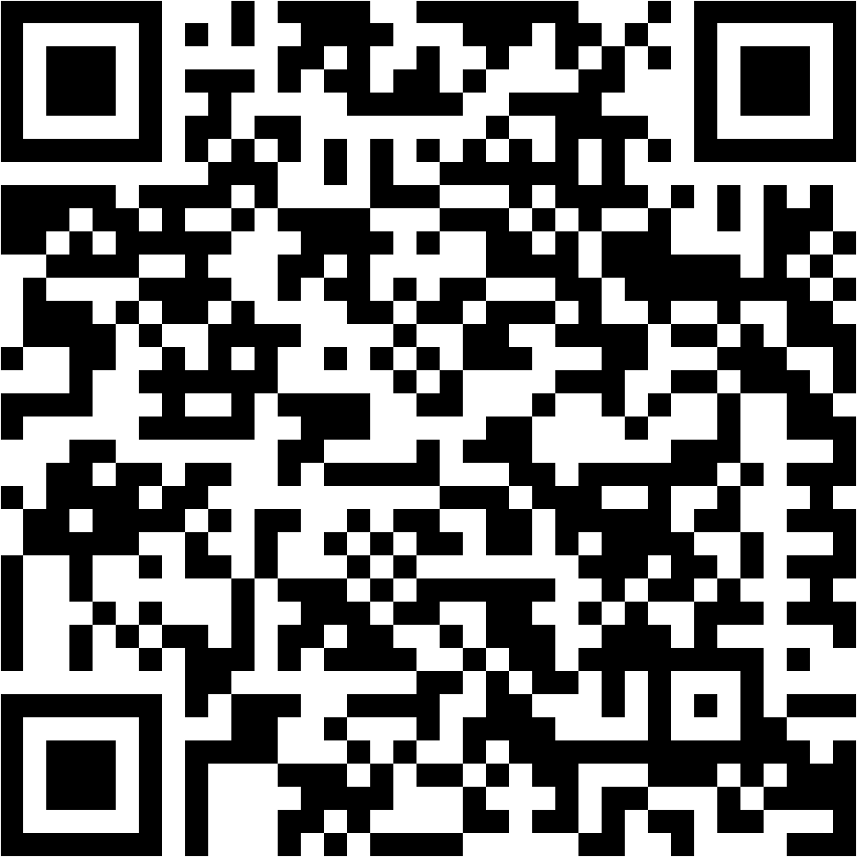
Impairment in Functioning and Quality of Life in Patients With Idiopathic Hypersomnia: the Real World Idiopathic Hypersomnia Outcomes Study (ARISE)
Logan Schneider, MD¹; Joanne Stevens, BA²; Aatif M. Husain, MD³; Diane Ito, MA⁴; Wayne Macfadden, MD²; Douglas S. Fuller, MS²; Phyllis Zee, MD, PhD⁵
¹Stanford University School of Medicine, Stanford, CA, USA; ²Jazz Pharmaceuticals, Philadelphia, PA, USA; ³Duke University Medical Center, Durham, NC, USA; ⁴Stratevi, Santa Monica, CA, USA; ⁵Feinberg School of Medicine, Northwestern University, Chicago, IL, USA
Scan this code to access this poster online.
This code is not for promotional purposes.

Slide 3
Conflicts of Interest and Disclosures
Logan Schneider has received honoraria as a member of advisory boards and speakers bureaus for Jazz Pharmaceuticals and Harmony Biosciences.
Joanne Stevens, Wayne Macfadden, and Douglas Fuller are full-time employees of Jazz Pharmaceuticals who, in the course of this employment, have received stock options exercisable for, and other stock awards of, ordinary shares of Jazz Pharmaceuticals, plc.
Aatif Husain has received consultancy fees and/or research funding from Jazz Pharmaceuticals, UCB, BlackThorn, Sage, Eisai, Marinus, and Neurelis, as well as royalties from Springer, Demos Medical, and Wolters Kluwer, and holds an editorship role with Wolters Kluwer.
Diane Ito is an employee of Stratevi, a consulting firm that received research funding from Jazz Pharmaceuticals to conduct this study.
Phyllis Zee serves on scientific advisory boards for Jazz Pharmaceuticals, Eisai, Idorsia, and Harmony Biosciences.
This study was supported by Jazz Pharmaceuticals.
3

Slide 4
Background and Objective
Idiopathic hypersomnia is a debilitating neurologic sleep disorder characterized by chronic excessive daytime sleepiness (the inability to stay awake and alert during the day, resulting in the irrepressible need to sleep or unplanned lapses into sleep or drowsiness)¹⁻³
Symptoms may also include severe sleep inertia (prolonged difficulty waking with frequent reentries into sleep, confusion, and irritability) as well as prolonged nighttime sleep, cognitive impairment, and long and unrefreshing naps^{1,3}
Idiopathic hypersomnia is poorly understood, with limited information regarding how the disorder impacts patients
The Real World Idiopathic Hypersomnia Outcomes Study (ARISE) evaluated the impact of idiopathic hypersomnia on participants’ lives and their perspectives of their current treatment
This presentation focuses on the quality of life (QoL) and functioning in participants with idiopathic hypersomnia
1. American Academy of Sleep Medicine. International Classification of Sleep Disorders. 3rd ed. Darien, IL: American Academy of Sleep Medicine; 2014. 2. Billiard M, Sonka K. Sleep Med Rev. 2016;29:23-33. 3. Trotti LM. Sleep Med Clin. 2017;12:331-4.
4

Slide 5
Methods
Eligible participants included adults between 21 and 65 years of age with a current diagnosis of idiopathic hypersomnia for at least 6 months and a typical nocturnal sleep time of at least 7 hours
This was a US-based virtual cross-sectional survey comprising multiple patient-reported outcome measures
Quality of life and functional impairment were assessed using 5 different scales:
Quality of Life in Neurological Disorders (Neuro-QoL; social roles and
stigma domains)¹
Functional Outcomes of Sleep Questionnaire-10, short version (FOSQ-10)²
Work Productivity and Activity Impairment Questionnaire: Specific Health
Problem (WPAI:SHP)³
British Columbia Cognitive Complaints Inventory (BC-CCI)⁴
Patient Health Questionnaire-9 (PHQ-9)⁵
1. Cella D, et al. Neurology. 2012;78:1860-7. 2. Chasens ER, et al. Sleep. 2009;32:915-9. 3. Reilly MC, et al. Pharmacoeconomics. 1993;4:353-65. 4. Iverson GL, Lam RW. Ann Clin Psychiatry. 2013;25(2):135-40. 5. Kroenke K, et al. J Gen Intern Med. 2001;16:606-13.
5

Slide 6
Demographic and Participant Characteristics
 | Participants (N=75)
Age, years, mean (SD) | 34.1 (10.7)
Female, n (%) | 61 (81.3)
Time since idiopathic hypersomnia diagnosis, years, n (%)
<2 | 12 (16.0)
2–4 | 34 (45.3)
5–9 | 18 (24.0)
≥10 | 11 (14.7)
Current comorbidity (≥5%),ª n (%)
Any psychiatric disorder | 33 (44.0)
Anxiety | 26 (34.7)
Major depressive disorder | 9 (12.0)
Bipolar disorder or any psychotic disorder | 6 (8.0)
Hypothyroidism | 6 (8.0)
PTSD | 5 (6.7)
Restless legs syndrome | 5 (6.7)
Other disorder that may be associated with excessive daytime sleepiness or fatigue^{b} | 5 (6.7)
PTSD, post-traumatic stress disorder; SD, standard deviation.
ªA participant could have had ≥1 comorbidity.
^{b}Included 1 person each who had depression; mild depression, possible attention-deficit disorder (but could be sleep disorder); persistent depressive disorder; small fiber neuropathy; and inflammatory bowel disease.
6

Slide 7
Demographic and Participant Characteristics (Cont’d)
 | Participants (N=75)
Current medication for idiopathic hypersomnia (≥5%), n (%)ª
Any | 67 (89.3)
Stimulants | 46 (61.3)
Wake-promoting agents | 21 (28.0)
Antidepressants | 14 (18.7)
Other^{b} | 5 (6.7)
Histamine receptor agent^{c} | 5 (6.7)
Sodium oxybate | 4 (5.3)
ªMedications are not necessarily mutually exclusive. Some participants reported taking multiple medications in these different classes. ^{b}Includes bupropion HCL, bupropion XL, flumazenil, levothyroxine. ^{c}Pitolisant.
7
Notes:
annotation for new data "Other" ICON_Jazz-ARISE_2021JUN24_v2.pdf p29C√
New annotations for “Histamine” and “Sodium oxybate”: ICON_Jazz-ARISE_2021JUN24_v2.pdf p29A√
New annotations for footnote “a”: ICON_Jazz-ARISE_2021JUN24_v2.pdf p30A√
New annotations for footnote “b”: ICON_Jazz-ARISE_2021JUN24_v2.pdf p29D√
New annotations for footnote “c”: ICON_Jazz-ARISE_2021JUN24_v2.pdf p30B√

Slide 8
Medication Usage for Idiopathic Hypersomnia
 | Participants (N=67)
Number of current idiopathic hypersomnia medication classesª, n (%)
1 | 46 (68.7)
2 | 10 (14.9)
3 | 8 (11.9)
4 | 3 (4.5)
8
ªCounts of medication classes used among respondents using at least 1 class.
Notes:
ICON_Jazz_ARISE_2021JUN24_v2.pdf p29 E, p30 C, D√

Slide 9
Neuro-QoL Social Rolesª and Stigma^{b} Domains
Worsening
Worsening
General population reference
T-score:
50.4 (SD=9.56)
Clinical population reference
T-score:
49.7 (SD=9.47)
n
Mean (SD)
Median (Q1, Q3)
75
43.4 (4.16)
42.7 (41.2, 45.2)
n
Mean (SD)
Median (Q1, Q3)
75
57.3 (5.88)
57.0 (53.7, 61.6)
9
Neuro-QoL, Quality of Life in Neurological Disorders; Q1, first quartile; Q3, third quartile; SD, standard deviation.
ªAbility to participate in social roles and activities.^{b}Perceptions of self and publicly enacted negativity, prejudice, and discrimination as a result disease-related manifestations.
Notes:
New annotations:
Social Roles: ARISE_20220204.pdf, p27A√
Stigma: ARISE_20220204.pdf, p27B√
Reference T-scores: Neuro-QoL_User_Manual_v2_24March2015.pdf p13A, p27A√
Update – split graph into 2

Slide 10
FOSQ-10 Score in Participants With Idiopathic Hypersomnia
Previously reported normal control value: 17.8 (SD=3.10)ª
Worsening
n
Mean (SD)
Median (Q1, Q3)
67
10.7 (2.78)
11.0 (8.7, 12.7)
FOSQ-10, Functional Outcomes of Sleep Questionnaire, short version; Q1, first quartile; Q3, third quartile; SD, standard deviation.
ªAs reported in a prior clinical study.¹
1. Chasens ER, et al. Sleep. 2009;32:915-9.
10

Slide 11
WPAI:SHP Scoresª in Participants With Idiopathic Hypersomnia
Worsening
n
Mean (SD)
Median (Q1, Q3)
56
12.3 (23.55)
0.0 (0.0, 14.3)
54
47.6 (22.73)
50.0 (30.0, 70.0)
54
51.4 (24.73)
53.9 (30.0, 71.4)
75
64.0 (21.93)
70.0 (50.0, 80.0)
The higher degree of presenteeism compared with absenteeism suggests work impairment in participants with idiopathic hypersomnia is driven more by decreased productivity while at work than lost work time
Q1, first quartile; Q3, third quartile; SD, standard deviation; WPAI:SHP, Work Productivity and Activity Impairment Questionnaire: Specific Health Problem.
ªItems relating to work productivity were completed only by participants who were employed; the item relating to activity impairment was completed by all participants.
^{b}Absenteeism was defined as percent work time missed due to idiopathic hypersomnia.
^{c}Presenteeism was defined as percent impairment while working due to idiopathic hypersomnia.
11

Slide 12
BC-CCI Score in Participants With Idiopathic Hypersomnia
Participants’ mean (SD) BC-CCI score was 10.8 (4.8), with 62.7% of participants reporting moderate to severe cognitive impairment
12
BC-CCI, British Columbia Cognitive Complaints Inventory; SD, standard deviation.
Notes:
New annotation for pie chart: ICON_Jazz_ARISE_2021JUN24_v2 p23A√

Slide 13
PHQ-9 Score in Participants With Idiopathic Hypersomnia
Minimal (<5)
Severe
(≥20)
Mild
(5–9)
Moderately Severe
(15–19)
Participants’ mean (SD) score on the PHQ-9 was 12.3 (5.4), with 66.7% of participants reporting moderate to severe depressive symptoms
Moderate
(10–14)
13
PHQ-9, Patient Health Questionnaire-9; SD, standard deviation.
Notes:
New annotation for pie chart: ICON_Jazz_ARISE_2021JUN24_v2 p24A√

Slide 14
Conclusions
Data from the ARISE study demonstrate that many people with idiopathic hypersomnia experience moderate to severe impairment in their quality of life across functional, social, and vocational domains
High scores on the NeuroQoL stigma domain indicated that patients with idiopathic hypersomnia feel alienated by their disease
Participants demonstrated high rates of presenteeism despite low absenteeism on the WPAI:SHP, indicating that work impairment is due to lost productivity associated with idiopathic hypersomnia
Over half of participants reported moderate or severe cognitive impairment on the BC-CCI, and two-thirds had moderate to severe depressive symptoms on the PHQ-9
These data emphasize the need for more effective and evidence-based treatments aimed at improving functioning and quality of life for people with idiopathic hypersomnia
BC-CCI, British Columbia Cognitive Complaints Inventory; Neuro-QoL, Quality of Life in Neurological Disorders; PHQ-9, Patient Health Questionnaire-9; WPAI:SHP, Work Productivity and Activity Impairment Questionnaire: Specific Health Problem.
14
Notes:
Annotations:
Bullet 2: Summarizes neuroqol figure - Stigma: ARISE_20220204.pdf, p27B; Reference T-scores: Neuro-QoL_User_Manual_v2_24March2015.pdf p13A, p27A√√
Bullet 3: Summarizes WPAI:SHP figure - ICON_Jazz_ARISE_2021JUN24_v2 p26A (absenteeism), p26B (presenteeism), p26C (absenteeism + presenteeism), 26D (activity impairment);√ 20210913.pdf (n, mean, SD, median, Q1, Q3) p7A (absenteeism) p7B (presenteeism), p7C (absenteeism + presenteeism), p7D (activity impairment)√
Bullet 4: Summarizes BC-CCI and PHQ-9 figures
BC-CCI: ICON_Jazz_ARISE_2021JUN24_v2 p22A – 36.0 + 26.7 > 50%√
PHQ-9: ICON_Jazz_ARISE_2021JUN24_v2 p24A – 24 + 19 + 7 = (50/75)*100 = 66.667%√

